Slide 1
Instacart Market Basket Analysis
Gareth Jobling, Suchetha Kadavgere, Xuanran Ji, Ananth GV

Slide 2

Introduction
Instacart has quickly become a leader in grocery delivery and pickup services.
In the uncertain times we live in today with COVID-19, we can see just how valuable a service like Instacart is
This is what peaked our interest to dive in and explore some of the data instacart has made available
This data can allow us to conduct a market basket analysis on frequently bought instacart products

Slide 3
Data Summary
Data was obtained from Kaggle. There are totally 6 files.
1)Aisle.csv : Data about Aisle
2)Departments_csv : Data about Different departments
3)Order_products_prior.csv : Data about each product ordered in every single order and if reordered
4)Order_products_train.csv :Data about each product ordered in every single order and if reordered
5)products_csv : Data about products
6)Orders_csv : Data about orders placed by the user and when it was placed.
The data was clean and we merged the tables using Tableau and excel.

Slide 4
Question 1: What category of products get reordered the most? The least?
Are there any products that get repeatedly reordered more frequently than others?
Do these products fall into a certain category?
What about the products that do not get reordered as frequently?
Is there any reason as to why?
?

Slide 5
Tests for Question 1
The first test I ran was an analysis by type of product (aisles) to display the % of time that product type was reordered
Using the same test we can also see which products get recorded less frequently
The last type of analysis uses how often the product type is reordered on average
This will help us to identify if these products are staples and are bought most times someone places an order or if they are one time purchases

Slide 6
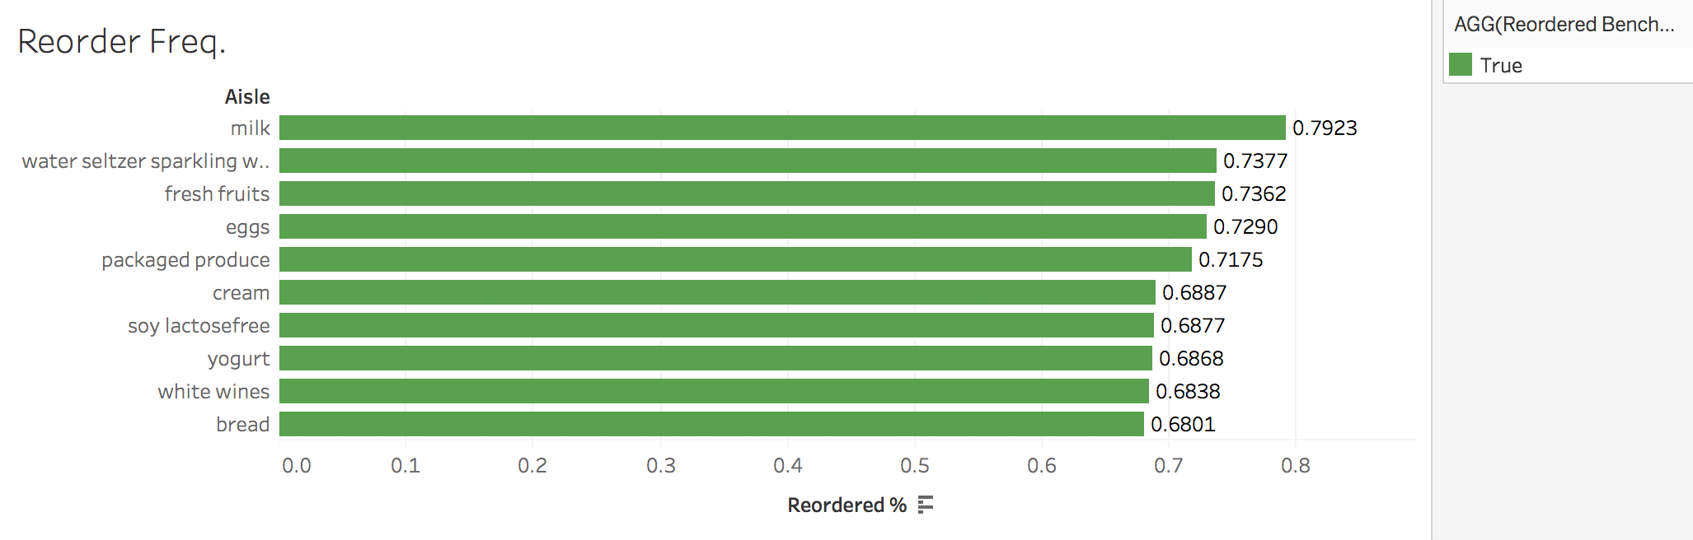
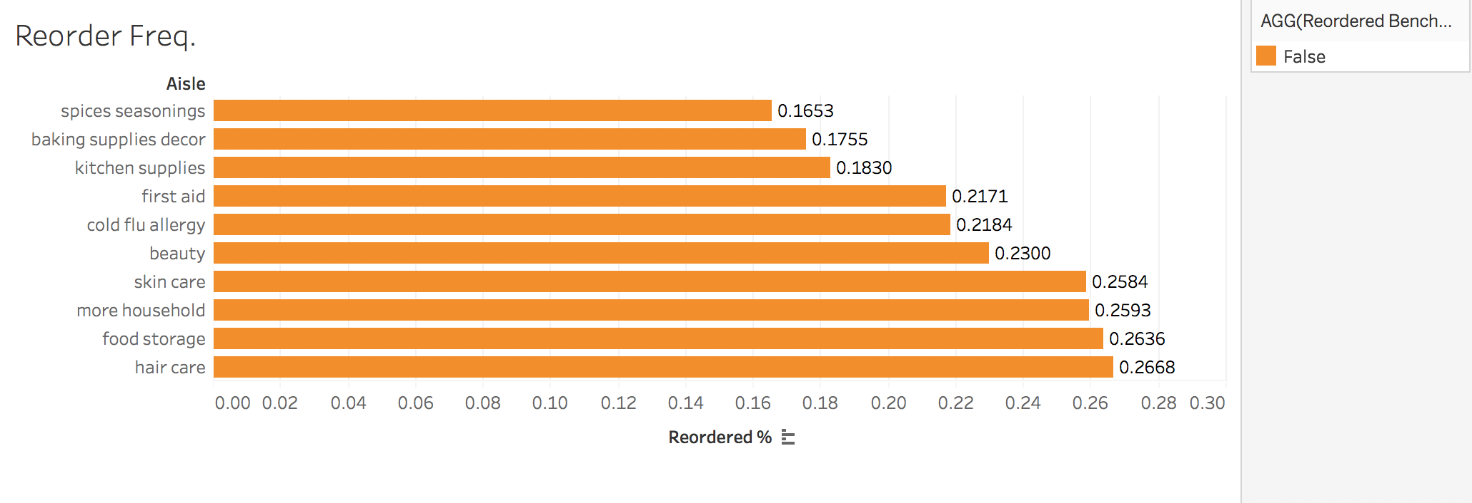
Question 1 Results
First chart shows us which category of products get reordered the most by percentage.
Second chart shows us which category of products get reordered the least by percentage.

Slide 7
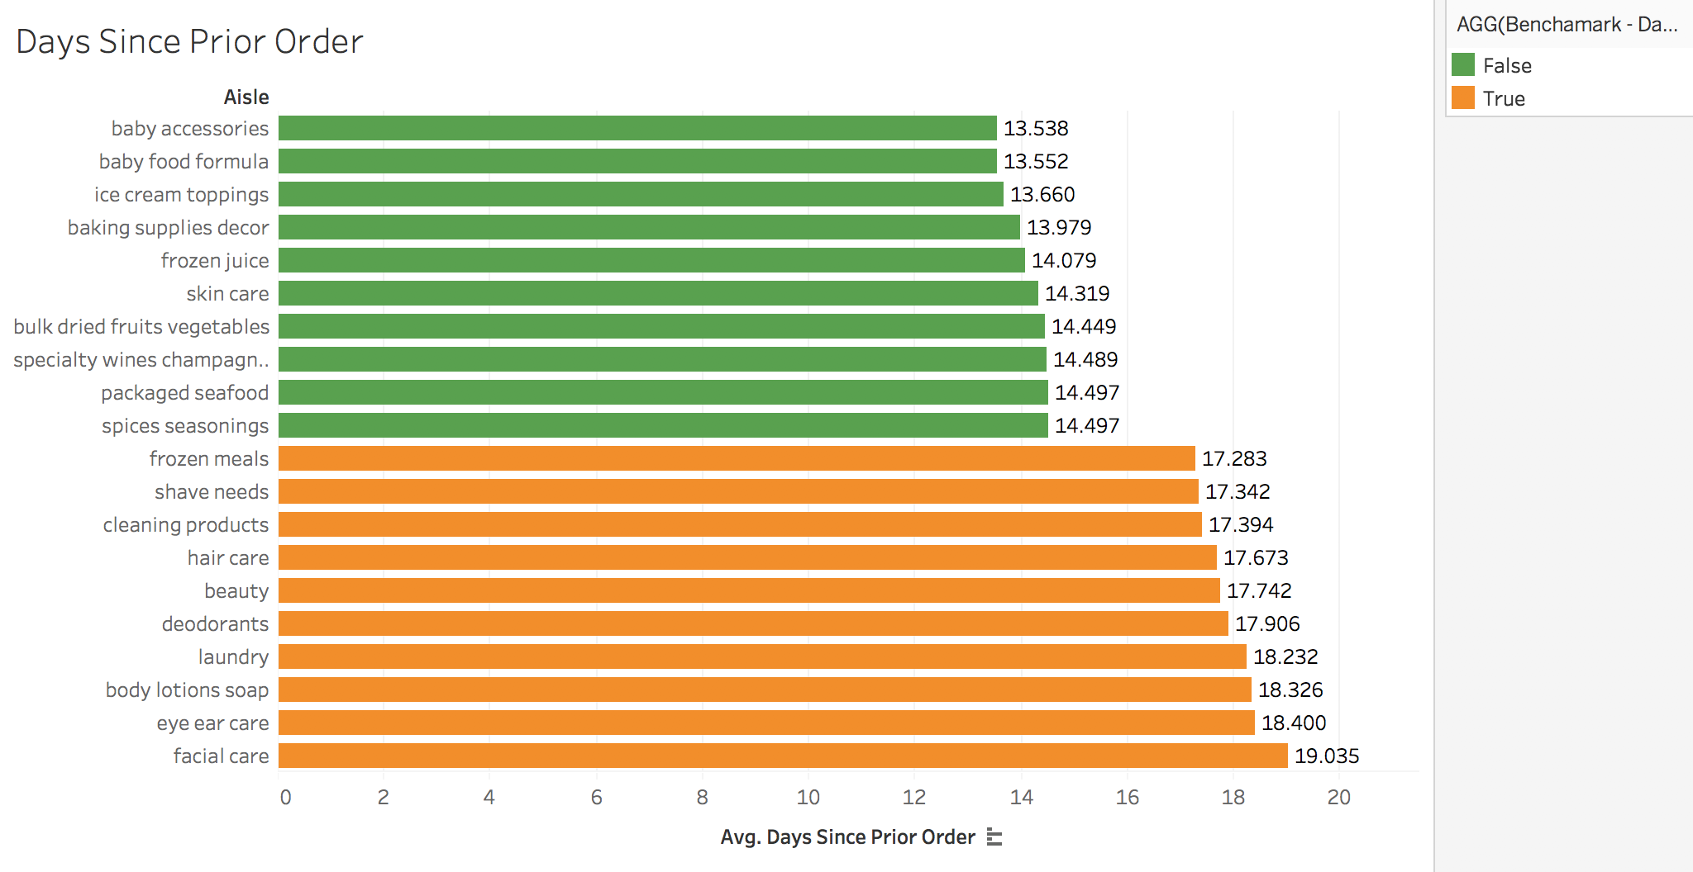
Question 1 Results
This chart shows us by product category which items get reordered the fastest, calculated as the average number of days since prior order.

Slide 8
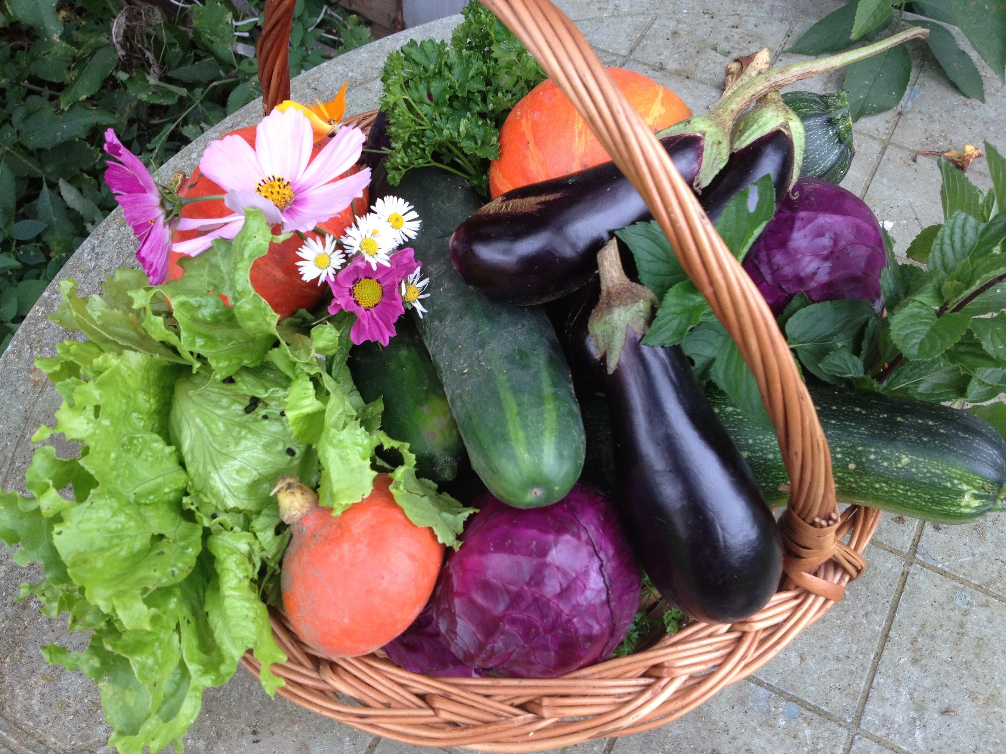
Question 2:
1)What day of week do people order the most?
2)How often do people reorder in days?
3)How many products are usually ordered at once?
4)Market Basket analysis

Slide 9
Tests for Question 2
1)The first thing looking at orders data was to analyse on which day was the traffic higher. I used a bar graph to explore on Tableau
2)To see the buying pattern from an application I used days_since_prior_order column to build a treemap.
3)Pivot table helped to get the number of products for each order_id and the frequency of the number of products with pivot charts gave an idea of the average number of products ordered at once.
4)To know which department should be placed where strategically, I used market basket analysis. I referred to videos on how to run a market basket analysis and created a dashboard to select different departments and see what was bought along with it the most number of times.

Slide 10
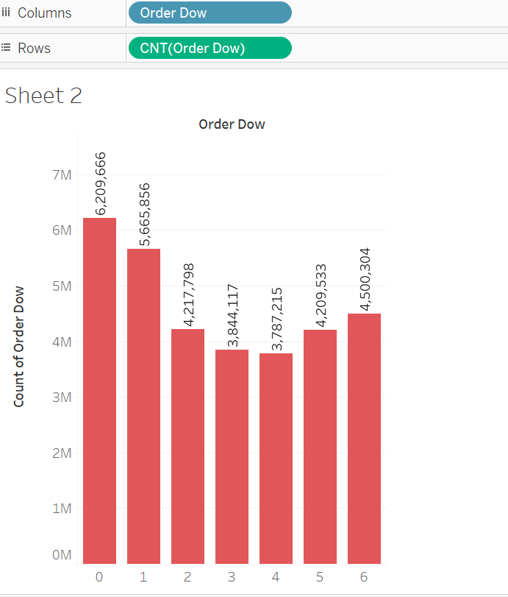
Question 2 Results
Most of the orders are made on 0 and 1 day of the week. Information about which day 0 is was not given but we can assume it’s sunday.

Slide 11
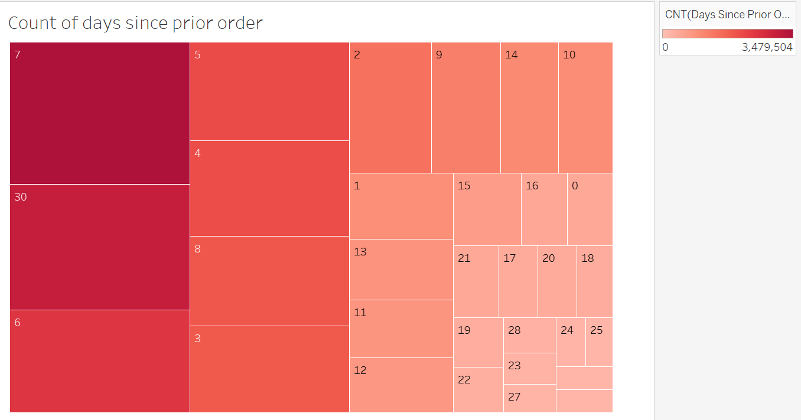
Question 2 Results
Looks like people reorder within 7 days more frequently followed by 30 days being the next frequent time period.

Slide 12
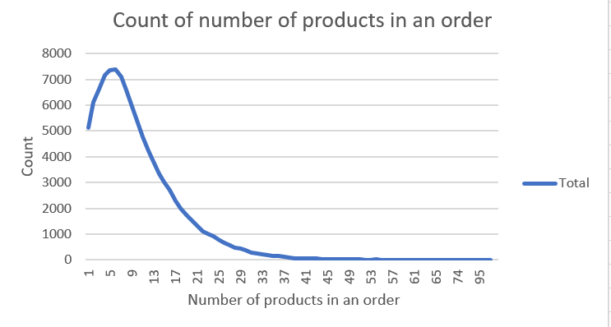
Question 2 Results
Mostly 7 to 9 products are ordered at once.

Slide 13
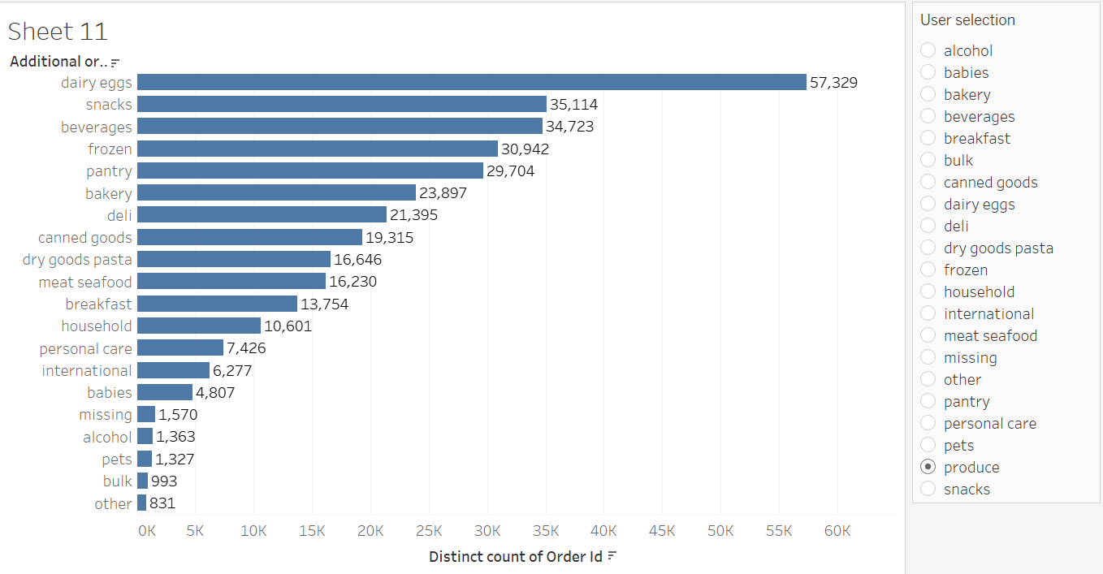
Question 2 Results
Dairy eggs seem to be in the basket a lot of times along with produce.

Slide 14
Question 3:
Which products and in which department make more sales on reorders?
What could be the reason behind the produce department having more reorders? Which other departments have low reorders and what additional attribute supports this answer?
What time of the day is the instacart used the most by customers?

Slide 15
Tests for Question 3
To understand what products were reordered the most and from which departments and time of the day, I joined all the secondary tables to form a primary table for the analysis.
In order to answer this question, I used products, orders, order_products__train, order_products__prior tables to do a group by and measure. We can see that the banana in produce is sold the most - 491,291.
If plotting the graph of departments and reorders, we can clearly see that the produce department generally has a greater reorder rate. The most obvious reason for this nature is the expiration of produce related products. Hence people generally tend to buy it every few days or so. The attribute that supports this answer is the average_days_since_prior_order. If we plot this we can see that alcohol has a reorder count of 102,221 but the average days since prior reorder is 13. But produce has most reorders (9888,378) but average days since prior order is 10.
This is essential to answer, because the application is not supposed to experience any downtime. We can ensure this by checking the usage statistics among customers. We plot the orders and reorders count against the time of the day. We can see that most people order products on instacart from 6am to 11pm. To be more specific, the usage is the most from 10m to 2pm.

Slide 16
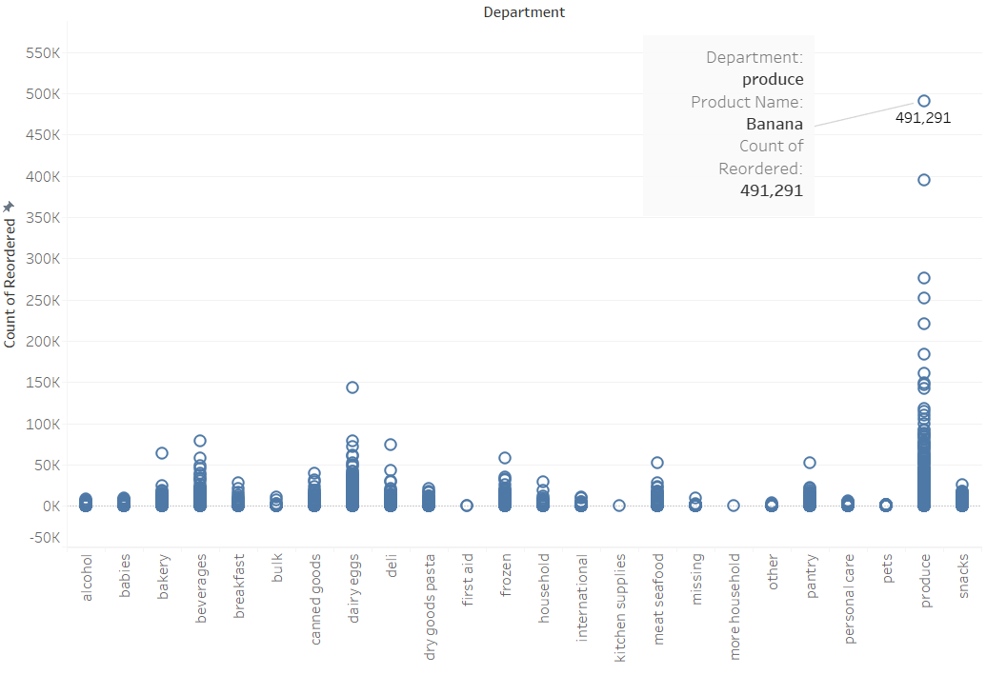
Question 3 Results
We can see that the banana in produce is sold the most - 491,291.

Slide 17
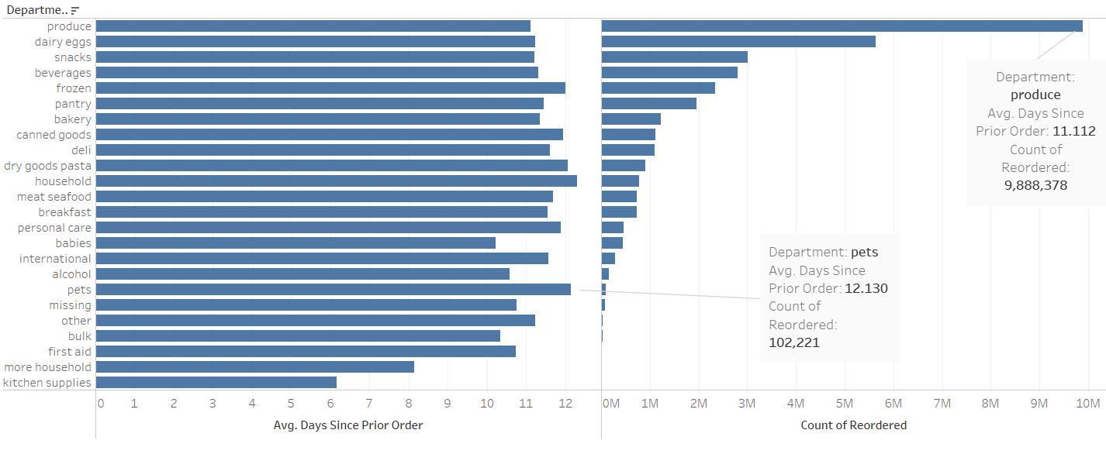
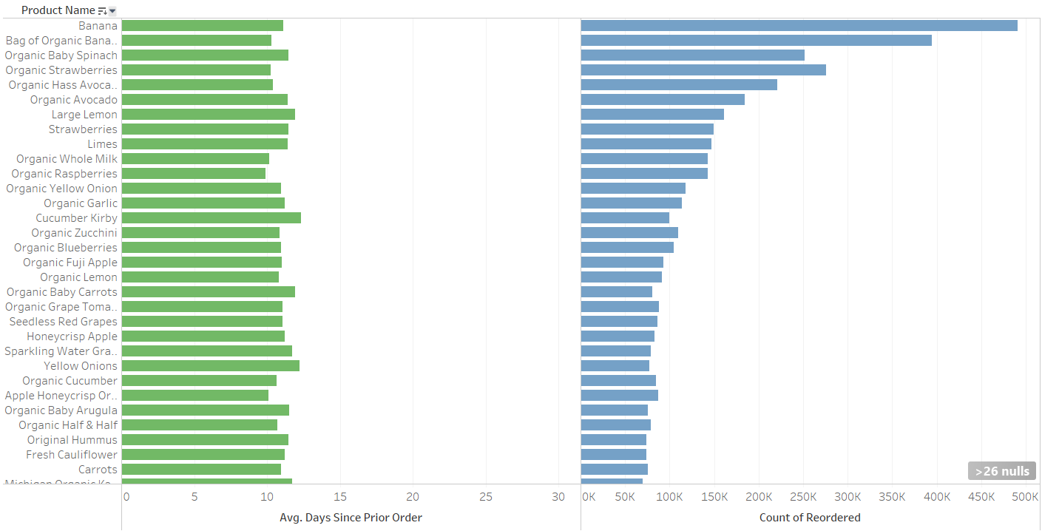
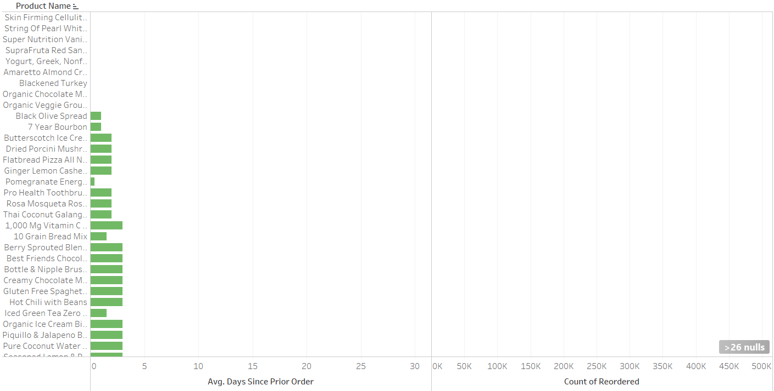
Question 3 Results
We can see that alcohol has a reorder count of 102,221 but the average days since prior reorder is 13. But produce has most reorders (9888,378) but average days since prior order is 10.

Slide 18
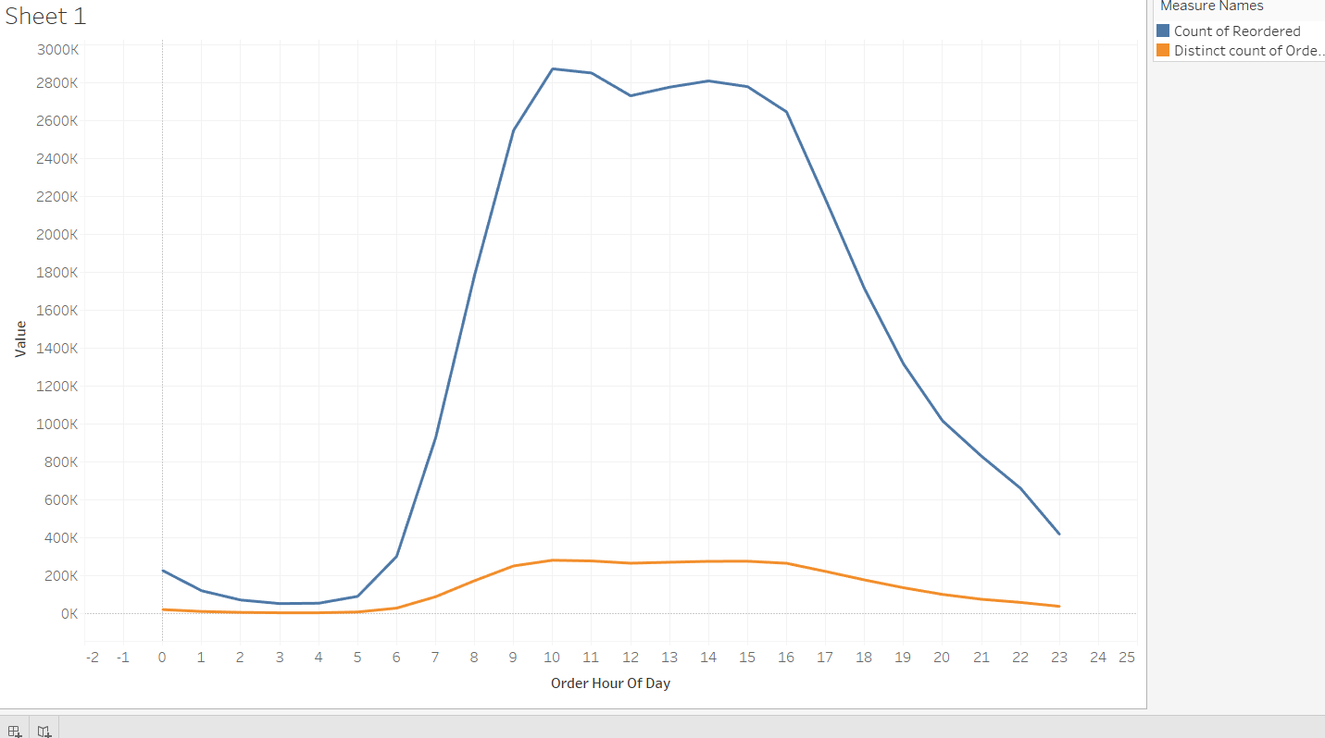
Question 3 Results
We can see that most people order products on instacart from 6am to 11pm. To be more specific, the usage is the most from 10m to 2pm.

Slide 19
Question 4
Which product is sold the most?
Among all products, Which products are more likely to be in added_to_cart_order from which Aisle, which department? Thoughts on organic products.
What’s the relationship between add to cart order and reorder order? Any specific pattern? If there is, please explain.

Slide 20
Test for question 4
1. By apply filter to product and Sum the number of the same product name. Using the circle chart to plot the result.
2. By joining department, aisles, products, order_products_prior, set product name, aisle, department as column and add_to_cart_order as row.
3. Using Excel to plot the Number of Add to cart order VS Reordered Ratio. What we did is to first group add to cart order by their number. Calculated reorderer ratio based by using sum of reordered order divided by total number of orders.

Slide 21
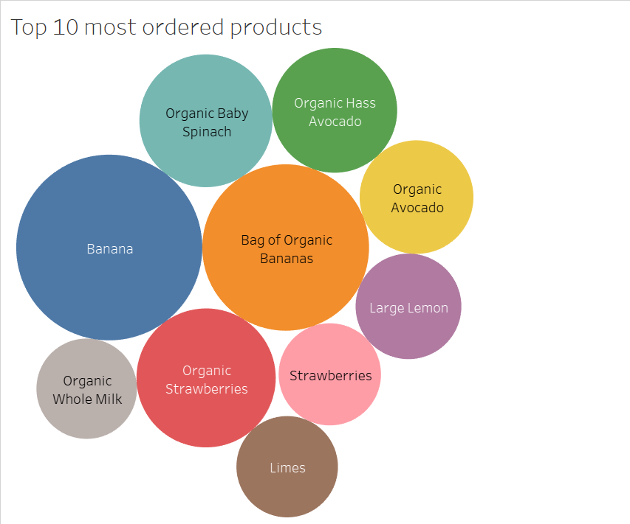
First test for question 4
We can see that banana is the most ordered products.
We also notice many popular products are organic

Slide 22
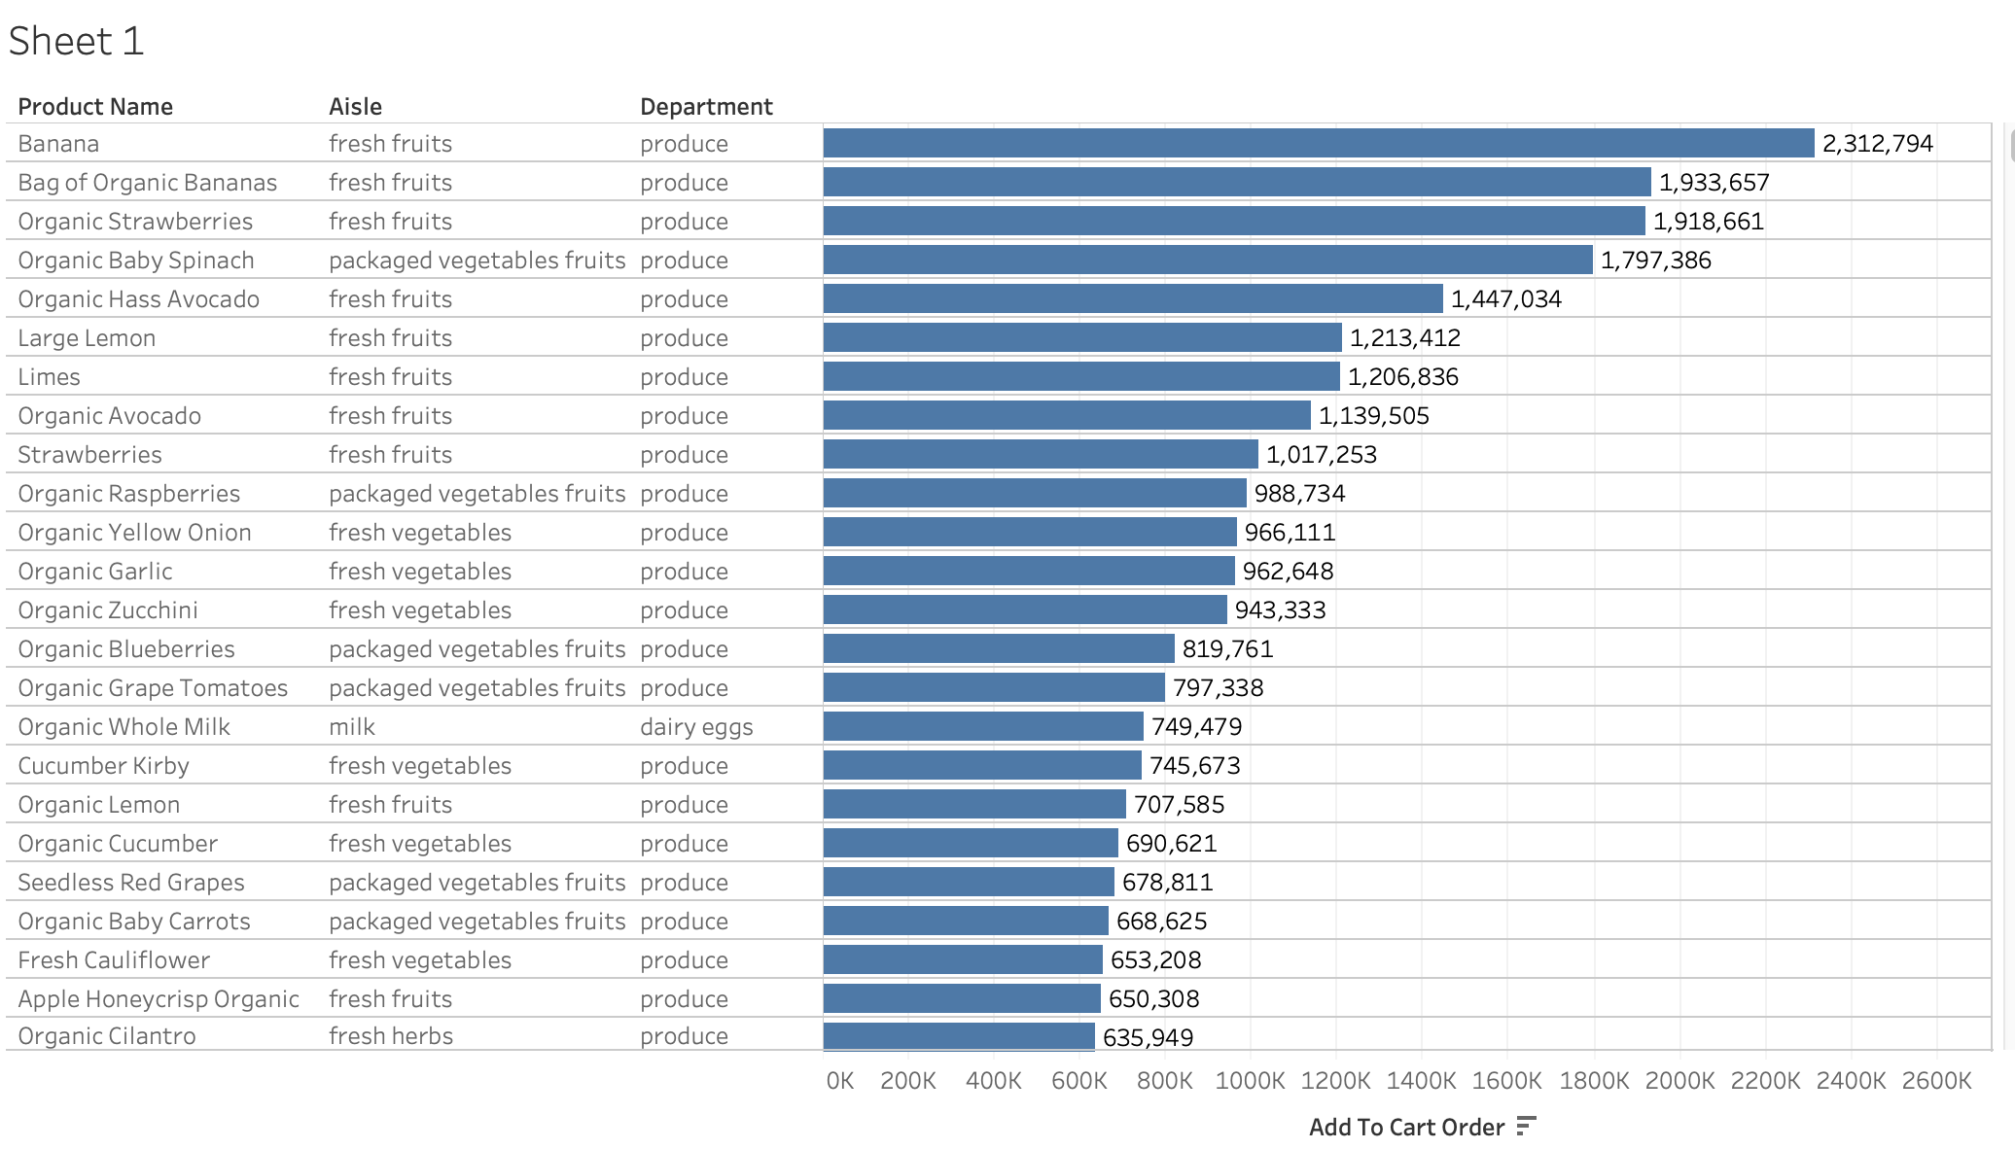
Second Test for question 4
As we can see, fresh vegetables from the produce department seem to be very popular.
We also notice that Organic food is also very popular VS non-organic food.
Using tableau filter, we found:
49667 different product names
5036 (10%) of product contains organic
44631 (90%)of product does not contains organic

Slide 23
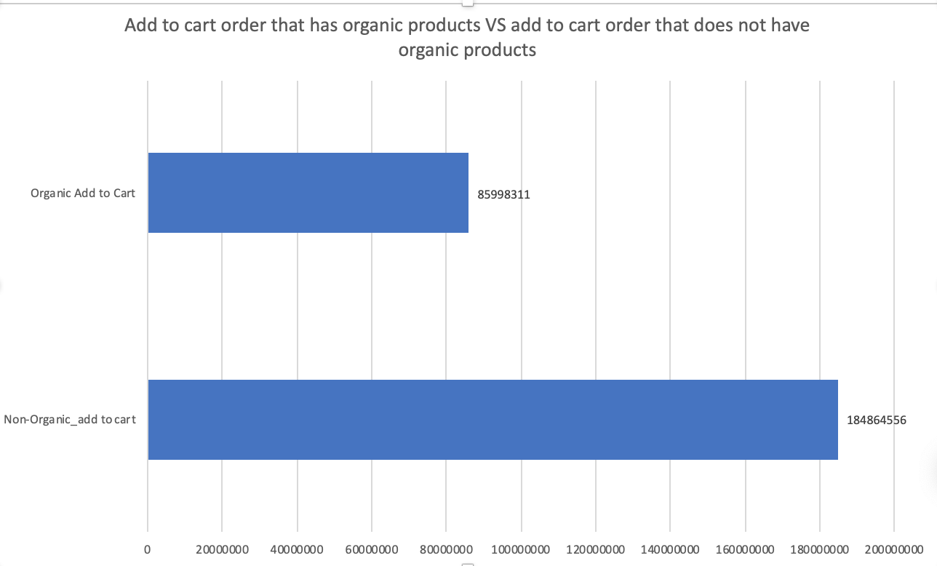
Second Test for question 4
About 32% of add to cart order has organic product in it.
About 68% of add to cart order does not have organic product in it.

Slide 24
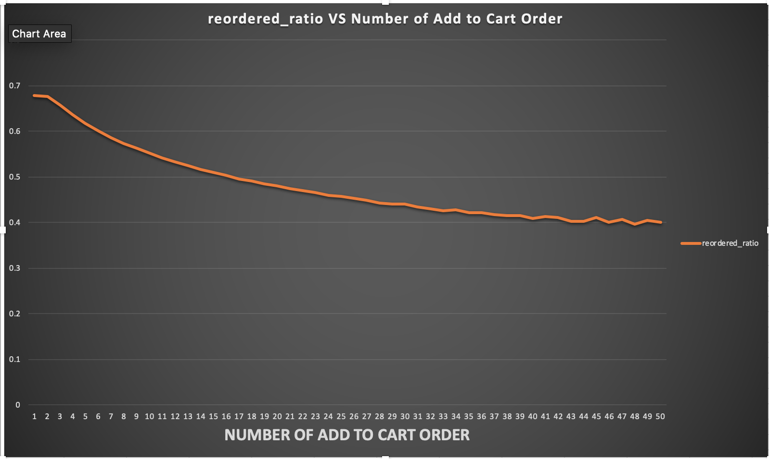
Third test for Question 4
We can see that the number of add to cart increasing, the reorder ratio decrease.

Slide 25
Conclusion
Products that get reordered the highest percent are staple items
Products that get reordered the least often are items that get used sparingly
Most of the orders are placed on sundays with average of 7 products.
Most of the reorders are weekly or monthly.
Market Basket analysis shows place produce next to dairy eggs, snacks and beverage close to each other.
Products that are added to the cart in the beginning are more likely to be reordered again compared to the ones added later
Produce is the largest department and organic products accounts for 10% of product category but account 30% in add to cart order.

Slide 26
Questions

